Slide 1








OLYMPIC
GAMES CASE
STUDY

Slide 2
Inroduction
The dataset, available on Kaggle, contains a historical record of the modern Olympic Games, spanning from Athens 1896 to Rio 2016. It offers an excellent opportunity to explore the evolution of the Olympics over time, focusing on various aspects such as the participation and achievements of women, the performance of different nations, and the development of sports and events. I plan to analyze this dataset using SQL to answer 20 insightful questions.
DataBase Structure:
The database consists of two table:
OLYMPICS_HISTORY and
OLYMPICS_HISTORY_NOC_REGIONS

Slide 3
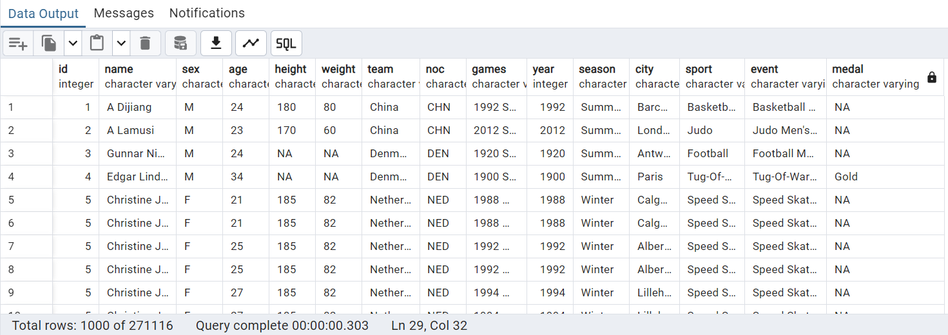
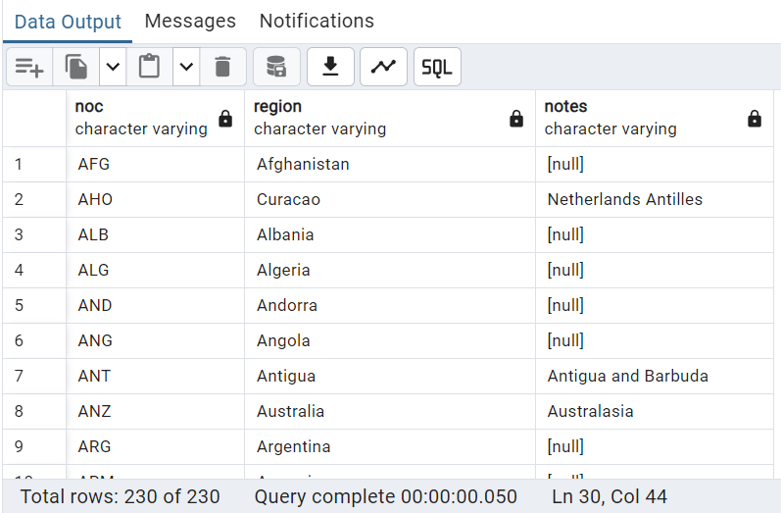
To start, I will create the necessary tables and import the dataset into them.
Output:
DROP TABLE IF EXISTS OLYMPICS_HISTORY;
CREATE TABLE IF NOT EXISTS OLYMPICS_HISTORY
(
id INT,
name VARCHAR,
sex VARCHAR,
age VARCHAR,
height VARCHAR,
weight VARCHAR,
team VARCHAR,
noc VARCHAR,
games VARCHAR,
year INT,
season VARCHAR,
city VARCHAR,
sport VARCHAR,
event VARCHAR,
medal VARCHAR
);
DROP TABLE IF EXISTS OLYMPICS_HISTORY_NOC_REGIONS;
CREATE TABLE IF NOT EXISTS OLYMPICS_HISTORY_NOC_REGIONS
(
noc VARCHAR,
region VARCHAR,
notes VARCHAR
);
select * from OLYMPICS_HISTORY;
select * from OLYMPICS_HISTORY_NOC_REGIONS;

Slide 4
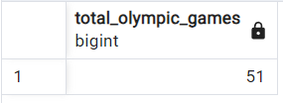
Problem Statement:
Here are the questions I addressed using SQL.
1. How many olympics games have been held?
Output:
SELECT
COUNT(DISTINCT(games)) AS total_olympic_games
FROM
olympics_history;

Slide 5
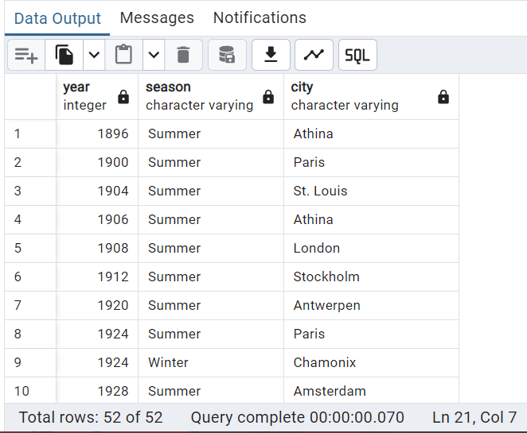
2. List down all Olympics games held so far.
Output:
SELECT
year,season,city
FROM
olympics_history
GROUP BY
year,season,city
ORDER BY
year;

Slide 6
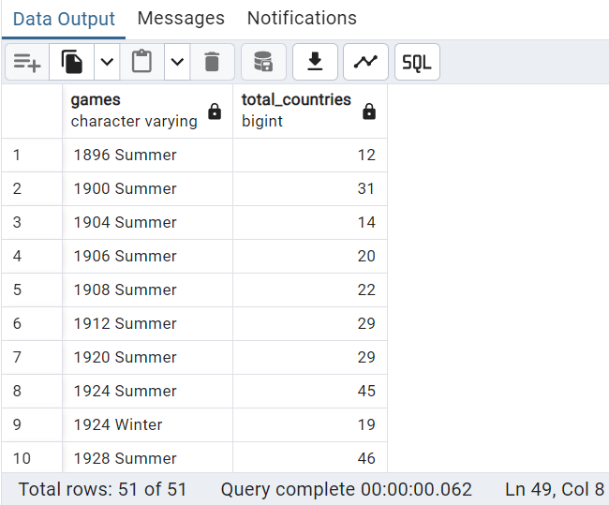
3. Mention the total no of nations who participated in each olympics game?
WITH all_countries AS (
SELECT
o.games,nr.region
FROM
olympics_history o
JOIN
olympics_history_noc_regions nr
ON
o.noc=nr.noc
GROUP BY
o.games,nr.region
)
SELECT
games,COUNT(1) AS total_countries
FROM
all_countries
GROUP BY
games
ORDER BY
games;
Output:

Slide 7
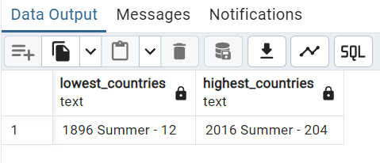
4. Which year saw the highest and lowest no of countries participating in olympics
WITH all_countries AS (
SELECT
oh.games,nr.region
FROM
OLYMPICS_HISTORY oh
JOIN
OLYMPICS_HISTORY_NOC_REGIONS nr
ON
oh.noc=nr.noc
GROUP BY
oh.games,nr.region
),
tot_countries AS(
SELECT
games,COUNT(*) AS total_countries
FROM
all_countries
GROUP BY
games
)
SELECT
CONCAT((
SELECT
games || ' - ' || total_countries
FROM
tot_countries
ORDER BY
total_countries ASC LIMIT 1
))
AS lowest_countries,
CONCAT((
SELECT
games || ' - ' || total_countries
FROM
tot_countries
ORDER BY
total_countries DESC LIMIT 1
))
AS highest_countries
FROM
tot_countries
LIMIT 1;
Output:

Slide 8
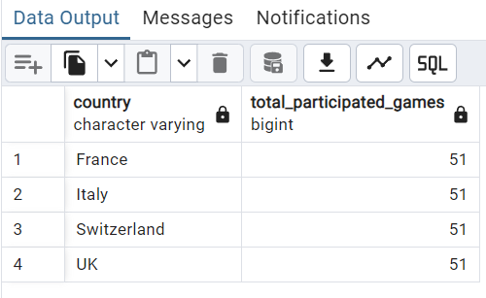
5. Which nation has participated in all of the olympic games
WITH tot_games AS(
SELECT
COUNT(DISTINCT games) AS total_games
FROM
olympics_history
),
countries AS(
SELECT
oh.games,nr.region AS country
FROM
olympics_history oh
JOIN
olympics_history_noc_regions nr
ON
oh.noc = nr.noc
GROUP BY
oh.games,nr.region
),
countries_participated AS(
SELECT
country,COUNT(1) AS total_participated_games
FROM
countries
GROUP BY
country
)
SELECT
cp.*
FROM
countries_participated cp
JOIN
tot_games tg
ON
cp.total_participated_games = tg.total_games
ORDER BY
1;
Output:

Slide 9
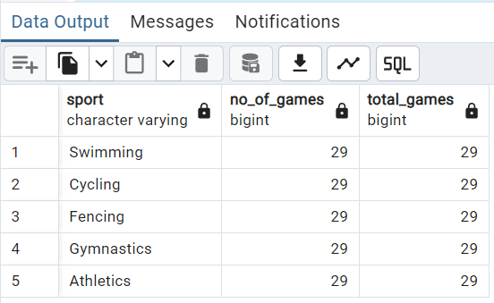
6. Identify the sport which was played in all summer olympics.
WITH t1 AS (
SELECT
COUNT(DISTINCT games) AS total_games
FROM
olympics_history
WHERE
season = 'Summer'
),
t2 AS (
SELECT
DISTINCT sport,games
FROM
olympics_history
WHERE
season = 'Summer'
ORDER BY
games
),
t3 AS (
SELECT
sport , COUNT(games) AS no_of_games
FROM
t2
GROUP BY
sport)
SELECT
t3.sport,t3.no_of_games,t1.total_games
FROM
t3
JOIN
t1
ON
t3.no_of_games = t1.total_games ;
Output:

Slide 10
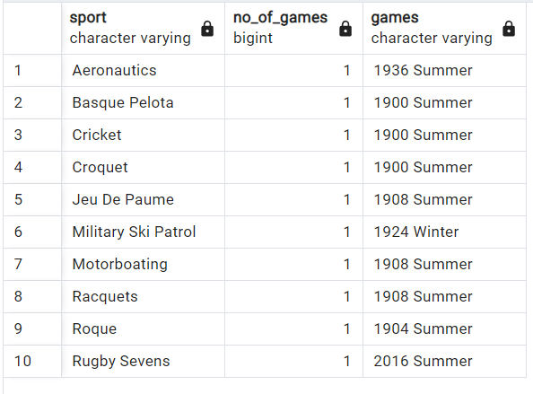
7. Which Sports were just played only once in the olympics.
WITH t1 AS (
SELECT
DISTINCT games,sport
FROM
olympics_history
ORDER BY
games
),
t2 AS (
SELECT
sport,COUNT(games) AS no_of_games
FROM
t1
GROUP BY
sport
)
SELECT
t1.sport,t2.no_of_games,t1.games
FROM
t2
JOIN
t1
ON
t1.sport = t2.sport
WHERE
t2.no_of_games = '1'
ORDER BY
t1.sport;
Output:

Slide 11
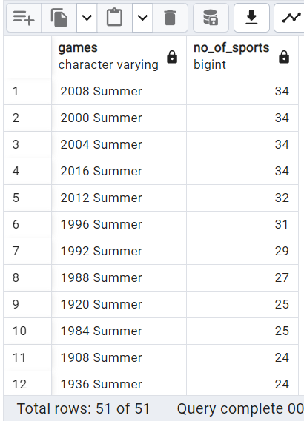
8. Fetch the total no of sports played in each olympic games.
SELECT
games,COUNT(DISTINCT sport) AS no_of_sports
FROM
olympics_history
GROUP BY
games
ORDER BY
no_of_sports DESC;
Output:

Slide 12
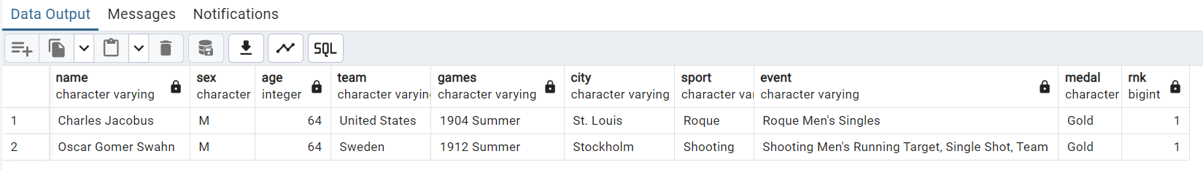
9. Fetch oldest athletes to win a gold medal.
WITH t1 AS (
SELECT
name,sex,CAST(CASE WHEN age = 'NA' THEN '0' ELSE age END AS int) as age,team,games,city,
sport,event,medal
FROM
olympics_history
),
rank AS (
SELECT
*,RANK() OVER(ORDER BY age DESC) AS rnk
FROM
t1
WHERE
medal = 'Gold'
)
SELECT
*
FROM
rank
WHERE
rnk = 1;
Output:

Slide 13
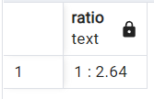
10.Find the Ratio of male and female athletes participated in all olympic games.
WITH t1 AS(
SELECT
sex, count(1) AS cnt
FROM
olympics_history
GROUP BY
sex),
t2 AS(
SELECT
*,ROW_NUMBER() OVER(ORDER BY cnt) AS rn
FROM
t1
),
min_cnt AS(
SELECT
cnt
FROM
t2
WHERE
rn = 1
),
max_cnt AS(
SELECT
cnt
FROM
t2
WHERE
rn = 2
)
SELECT
CONCAT('1 : ', ROUND(max_cnt.cnt::decimal/min_cnt.cnt, 2)) AS ratio
FROM
min_cnt, max_cnt;
Output:

Slide 14
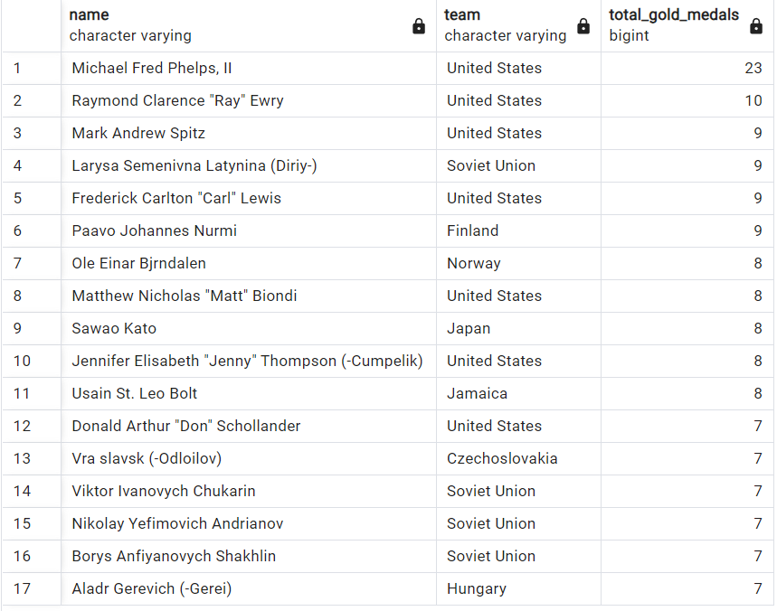
11. Fetch the top 5 athletes who have won the most gold medals.
WITH RankedMedals AS (
SELECT
name,team,COUNT(1) AS total_gold_medals,DENSE_RANK() OVER (ORDER BY COUNT(1) DESC) AS rank
FROM
OLYMPICS_HISTORY
WHERE
medal = 'Gold'
GROUP BY
name, team
)
SELECT
name,team,total_gold_medals
FROM
RankedMedals
WHERE
rank <= 5
ORDER BY
rank, total_gold_medals DESC;
Output:

Slide 15
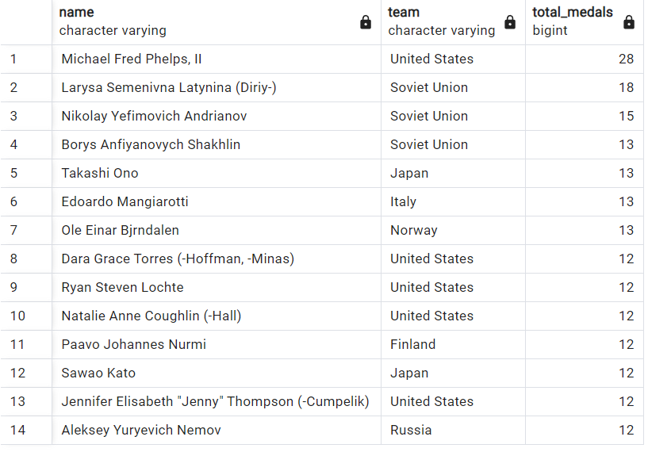
12. Fetch the top 5 athletes who have won the most medals (gold/silver/bronze).
WITH RankedMedals AS (
SELECT
name,team,COUNT(1) AS total_medals,DENSE_RANK() OVER (ORDER BY COUNT(1) DESC) AS rank
FROM
OLYMPICS_HISTORY
WHERE
medal in ('Gold', 'Silver', 'Bronze')
GROUP BY
name, team
)
SELECT
name,team,total_medals
FROM
RankedMedals
WHERE
rank <= 5
ORDER BY
rank, total_medals DESC;
Output:

Slide 16
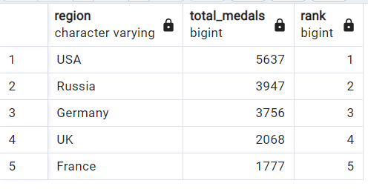
13. Fetch the top 5 most successful countries in olympics. Success is defined by no of medals won.
WITH RankedMedals AS (
SELECT
nr.region,COUNT(o.Medal) AS total_medals,DENSE_RANK() OVER (ORDER BY COUNT(1) DESC) AS rank
FROM
OLYMPICS_HISTORY o
JOIN
OLYMPICS_HISTORY_NOC_REGIONS nr
ON
o.noc = nr.noc
WHERE
medal <> 'NA'
GROUP BY
nr.region
ORDER BY
total_medals DESC
)
SELECT
region,total_medals,rank
FROM
RankedMedals
WHERE
rank <= 5
ORDER BY
rank, total_medals DESC;
Output:

Slide 17
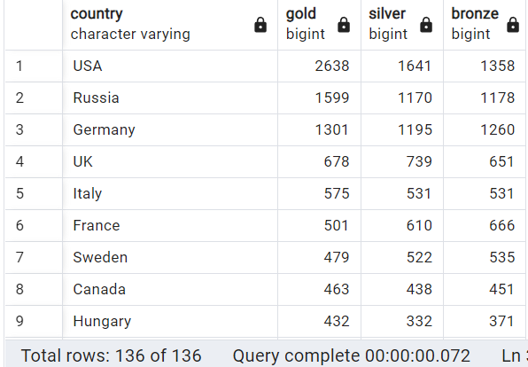
14. List down total gold, silver and bronze medals won by each country.
CREATE EXTENSION TABLEFUNC;
SELECT
country
, coalesce(gold, 0) as gold
, coalesce(silver, 0) as silver
, coalesce(bronze, 0) as bronze
FROM CROSSTAB('
SELECT
nr.region AS country,o.medal,COUNT(1) AS total_medals
FROM
OLYMPICS_HISTORY o
JOIN
OLYMPICS_HISTORY_NOC_REGIONS nr
ON
o.noc = nr.noc
WHERE
medal <> ''NA''
GROUP BY
nr.region,o.medal
ORDER BY
nr.region,o.medal',
'VALUES (''Bronze''),(''Gold''),(''Silver'')')
AS FINAL_RESULT(country varchar, bronze bigint, gold bigint, silver bigint)
ORDER BY
gold DESC, silver DESC, bronze DESC;
Output:

Slide 18
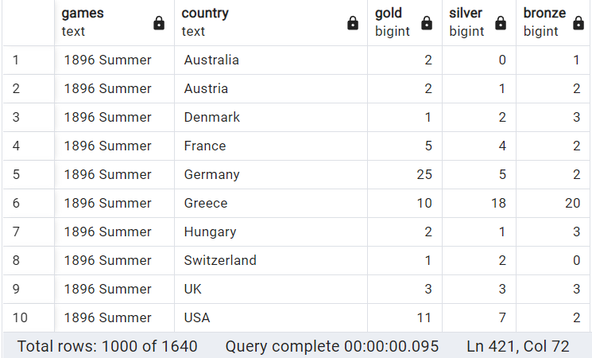
15. List down total gold, silver and bronze medals won by each country corresponding to each olympic games.
SELECT substring(games,1,position(' - ' in games) - 1) as games
, substring(games,position(' - ' in games) + 3) as country
, coalesce(gold, 0) as gold
, coalesce(silver, 0) as silver
, coalesce(bronze, 0) as bronze
FROM CROSSTAB('
SELECT CONCAT(games, '' - '', nr.region) as games, medal, count(1) as total_medals
FROM
olympics_history oh
JOIN
olympics_history_noc_regions nr ON nr.noc = oh.noc
WHERE
medal <> ''NA''
GROUP BY
games,nr.region,medal
ORDER BY
games,medal',
'values (''Bronze''), (''Gold''), (''Silver'')')
AS FINAL_RESULT(games text, bronze bigint, gold bigint, silver bigint);
Output:

Slide 19
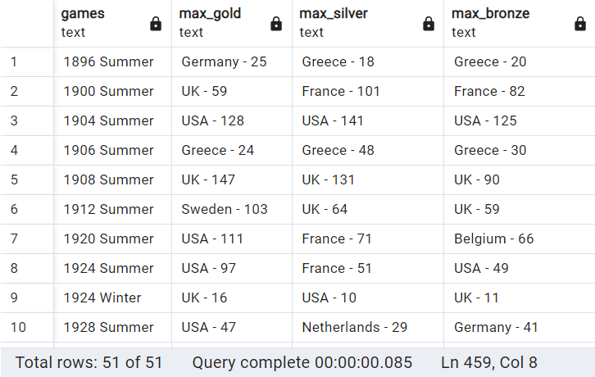
16. Identify which country won the most gold, most silver and most bronze medals in each olympic games.
WITH temp AS(
SELECT substring(games,1,position(' - ' in games) - 1) as games
, substring(games,position(' - ' in games) + 3) as country
, coalesce(gold, 0) as gold
, coalesce(silver, 0) as silver
, coalesce(bronze, 0) as bronze
FROM CROSSTAB('
SELECT CONCAT(games, '' - '', nr.region) as games, medal, count(1) as total_medals
FROM
olympics_history oh
JOIN
olympics_history_noc_regions nr ON nr.noc = oh.noc
WHERE
medal <> ''NA''
GROUP BY
games,nr.region,medal
ORDER BY
games,medal',
'values (''Bronze''), (''Gold''), (''Silver'')')
AS FINAL_RESULT(games text, bronze bigint, gold bigint, silver bigint)
)
SELECT
DISTINCT games,
CONCAT(FIRST_VALUE(country) OVER(PARTITION BY games ORDER BY gold DESC), ' - ',
FIRST_VALUE(gold) OVER(PARTITION BY games ORDER BY gold DESC)) AS Max_Gold,
CONCAT(FIRST_VALUE(country) OVER(PARTITION BY games ORDER BY silver DESC), ' - ',
FIRST_VALUE(silver) OVER(PARTITION BY games ORDER BY silver DESC)) AS Max_Silver,
CONCAT(FIRST_VALUE(country) OVER(PARTITION BY games ORDER BY bronze DESC), ' - ',
FIRST_VALUE(bronze) OVER(PARTITION BY games ORDER BY bronze DESC)) AS Max_Bronze
FROM
temp
ORDER BY
games;
Output:

Slide 20
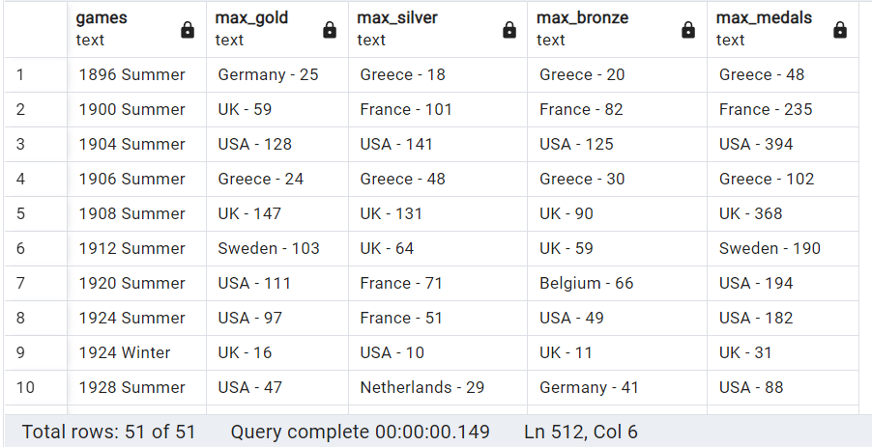
17. Identify which country won the most gold, most silver, most bronze medals and the most medals in each olympic games.
WITH temp AS(
SELECT substring(games,1,position(' - ' in games) - 1) as games
, substring(games,position(' - ' in games) + 3) as country
, coalesce(gold, 0) as gold
, coalesce(silver, 0) as silver
, coalesce(bronze, 0) as bronze
FROM CROSSTAB('
SELECT CONCAT(games, '' - '', nr.region) as games, medal, count(1) as total_medals
FROM
olympics_history oh
JOIN
olympics_history_noc_regions nr ON nr.noc = oh.noc
WHERE
medal <> ''NA''
GROUP BY
games,nr.region,medal
ORDER BY
games,medal',
'values (''Bronze''), (''Gold''), (''Silver'')')
AS FINAL_RESULT(games text, bronze bigint, gold bigint, silver bigint)
),
tot_medals AS(
SELECT
o.games,nr.region AS country , COUNT(1) AS total_medals
FROM
OLYMPICS_HISTORY o
JOIN
OLYMPICS_HISTORY_NOC_REGIONS nr
ON
o.noc = nr.noc
WHERE
medal <> 'NA'
GROUP BY
o.games,nr.region
ORDER BY
1,2
)
SELECT
DISTINCT t.games,
CONCAT(FIRST_VALUE(t.country) OVER(PARTITION BY t.games ORDER BY gold DESC), ' - ',
FIRST_VALUE(gold) OVER(PARTITION BY t.games ORDER BY gold DESC)) AS Max_Gold,
CONCAT(FIRST_VALUE(t.country) OVER(PARTITION BY t.games ORDER BY silver DESC), ' - ',
FIRST_VALUE(silver) OVER(PARTITION BY t.games ORDER BY silver DESC)) AS Max_Silver,
CONCAT(FIRST_VALUE(t.country) OVER(PARTITION BY t.games ORDER BY bronze DESC), ' - ',
FIRST_VALUE(bronze) OVER(PARTITION BY t.games ORDER BY bronze DESC)) AS Max_Bronze,
CONCAT(FIRST_VALUE(t.country) OVER(PARTITION BY t.games ORDER BY total_medals DESC), ' - ',
FIRST_VALUE(tm.total_medals) OVER(PARTITION BY t.games ORDER BY tm.total_medals DESC)) AS Max_medals
FROM
temp t
JOIN
tot_medals tm
ON
t.games = tm.games and t.country = tm.country
ORDER BY
t.games;
Output:

Slide 21
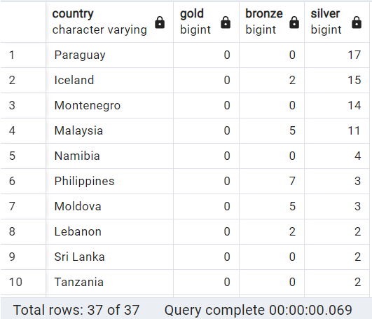
18. Which countries have never won gold medal but have won silver/bronze medals?
WITH temp AS(
SELECT country
, coalesce(gold, 0) as gold
, coalesce(bronze, 0) as bronze
, coalesce(silver, 0) as silver
FROM CROSSTAB('
SELECT nr.region AS country, medal, count(1) as total_medals
FROM
olympics_history oh
JOIN
olympics_history_noc_regions nr
ON
nr.noc = oh.noc
WHERE
medal <> ''NA''
GROUP BY
nr.region,medal
ORDER BY
nr.region,medal',
'values (''Bronze''), (''Gold''), (''Silver'')')
AS FINAL_RESULT(country varchar, bronze bigint, gold bigint, silver bigint)
)
SELECT
*
FROM
temp
WHERE
gold = 0 and (silver > 0 or bronze >0)
ORDER BY
gold DESC nulls last, silver DESC nulls last, bronze DESC nulls last;
Output:

Slide 22
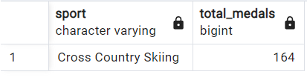
19. In which Sport/event, Norway has won highest medals.
WITH t1 AS(
SELECT
sport,COUNT(1) AS total_medals
FROM
OLYMPICS_HISTORY
WHERE
medal <> 'NA'
AND
team = 'Norway'
GROUP BY
sport
ORDER BY
total_medals DESC),
t2 AS(
SELECT
*,RANK() OVER (ORDER BY total_medals DESC) as rnk
FROM
t1
)
SELECT
sport,total_medals
FROM
t2
WHERE
rnk = 1;
Output:

Slide 23
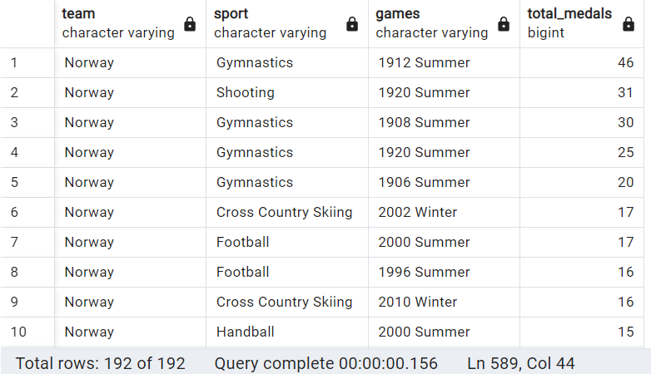
20. Break down all olympic games where Norway won medal for Hockey and how many medals in each olympic games.
SELECT
team,sport,games,COUNT(1) AS total_medals
FROM
OLYMPICS_HISTORY
WHERE
medal <> 'NA'
AND
team = 'Norway'
GROUP BY
team,sport,games
ORDER BY
total_medals DESC;
Output:

Slide 24
End of Sql Case Study
Thank You For Watching

